Slide 1
Computer Vision Fundamentals
Lecture 2 - Part 3
Vectorization and Plots

Slide 2
Contents
Vectorization
Plots

Slide 3

Vectorization
Vectorization in Matlab allows us to dispense with loops in almost all instances, and is a very efficient replacement for them.
For example, suppose we wish to calculate the sine values of all the integer radians one to one million. We can do this with a for loop
>> for i = 1 : 10 ^ 6 , sin( i ) ; end ;
We can perform the same calculation with:
>> i = 1 : 10 ^ 6 , sin( i );
and print out the elapsed time with:
>> tic , i ; toc

Slide 4
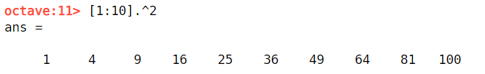
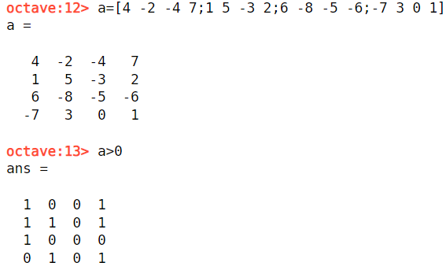
More examples….
As another example, we can easily generate the first 10 square numbers with:
>> [ 1 : 10 ] . ^ 2
Vectorization can also be used with logical operators; we can obtain all positive elements of the matrix a above with:
>> a > 0

Slide 5
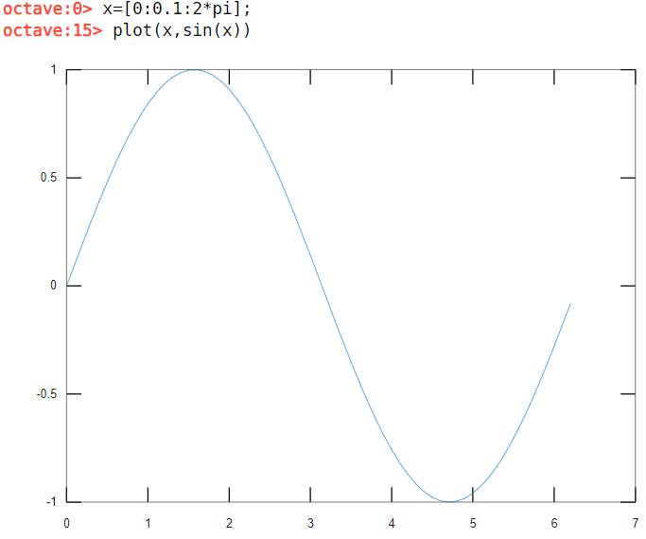
Plots
Matlab has outstanding graphics capabilities. But we shall just look at some simple plots. The idea is straightforward: we create two vectors x and y of the same size, then the command
>> plot( x , y )
will plot y against x. If y has been created from x by using a vectorized function f ( x )
the plot will show the graph of y = f ( x ) .

Slide 6
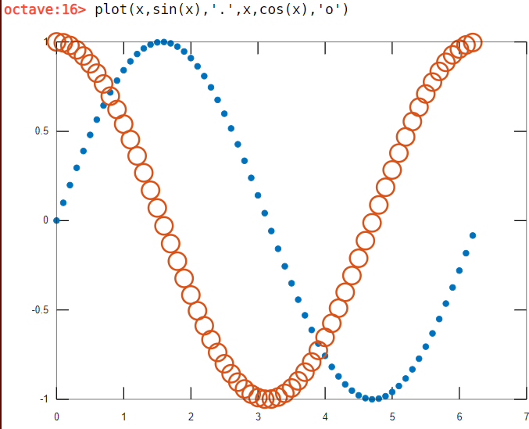
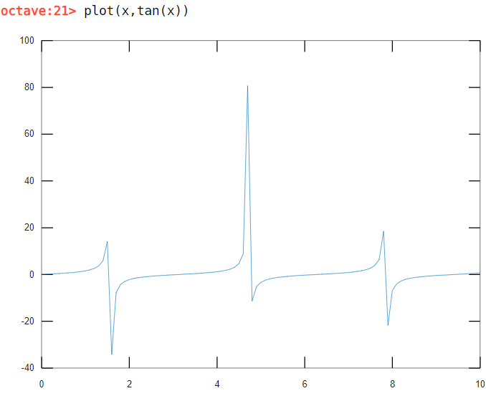
More examples…
Notes:
x=[0:0.1:10]
plot(x,tan(x))
figure,plot(x,tan(x)),axis([0,10,-10,10])

Slide 7
Thankyou

